Slide 1
TITLE : Retail Database Project Overview
Retail
Database
Purpose: Build a retail database to manage customers, products, orders, and returns.
Technologies: SQL relational database (MySQL).
Importance: Helps analyze sales, customer behaviour, and product performance.
1
Prepared by Lokesh Kumar Sundarasetty

Slide 2
TITLE : Database Schema and Relationships
Tables Created:
Customers, Products, orders, order_items, Returns
Primary and Foreign Keys ensure data integrity.
Table Relationships :
Customers place Orders
Orders include multiple Order_Items
Order_Items link Products
Returns relate to Order_Items
2

Slide 3
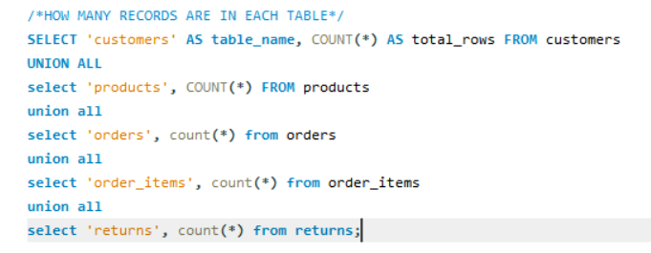

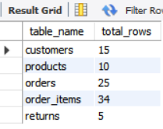
QUERY : Number of Records in Each Table
Result
Insight
This query confirms the size and integrity of each table.
Ensures data is loaded correctly and provides a baseline for analysis volume.
3

Slide 4
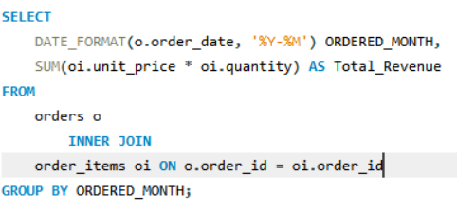

QUERY : Total Sales Revenue By Month
Result
Insight
Shows how sales fluctuate over time, helping identify seasonal trends, peaks, or dips.
Useful for forecasting and planning inventory or marketing campaigns.
4

Slide 5
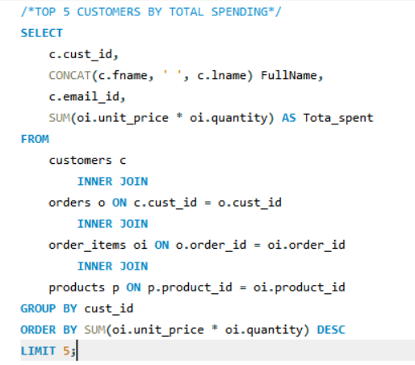
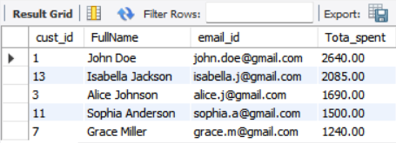
QUERY : Customers with Highest Total Spending
Insight
Identifies your most valuable customers driving the majority of revenue.
Can be used to tailor loyalty programs, VIP treatment, or targeted promotions.
5

Slide 6
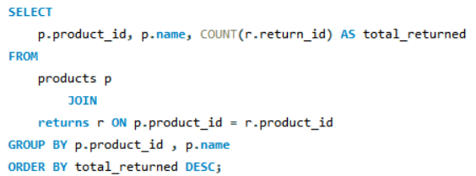
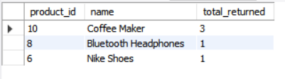
QUERY : Products With Highest Returns
Result
Insight
Highlights products with high return counts, potentially indicating quality issues or misaligned customer expectations.
Can focus quality assurance efforts or reconsider product offerings.
6

Slide 7
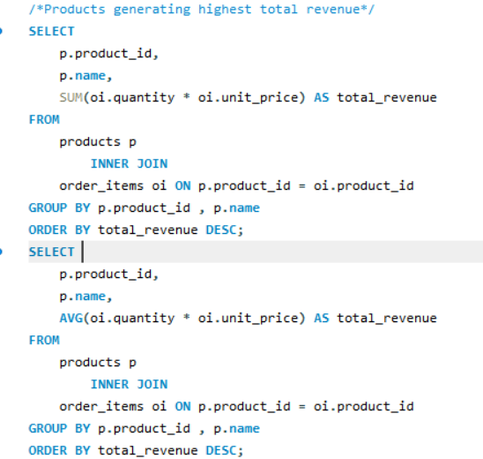
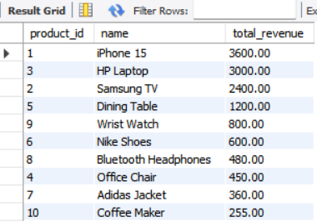
QUERY : Top Revenue generating products
Result
Insight
Reveals which products contribute the largest share of income, guiding product prioritization and inventory stocking.
May overlap with top returned products, showing a trade-off between popularity and returns.
7

Slide 8
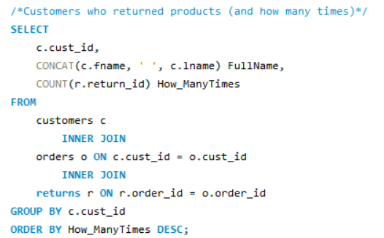
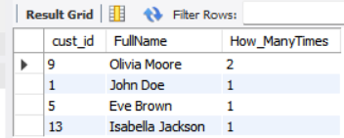
QUERY : Customers and Their Return Counts
Result
Insight
Tracks customers who return products frequently, useful for customer service or fraud detection.
Helps assess customer satisfaction and identify potential churn risks.
8

Slide 9
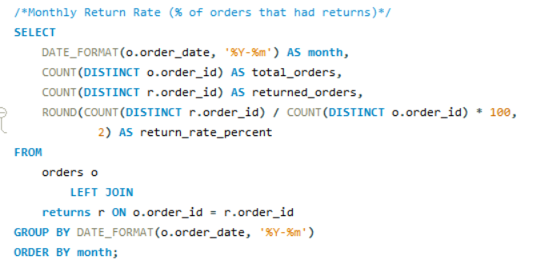

QUERY : Return Rate Over Time
Result
Insight
Displays the proportion of orders resulting in returns each month, indicating trends in product satisfaction or service quality.
Sudden spikes may signal issues requiring prompt investigation.
9

Slide 10
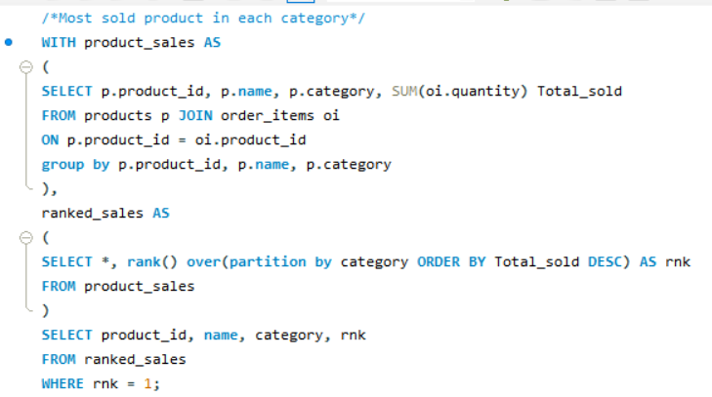
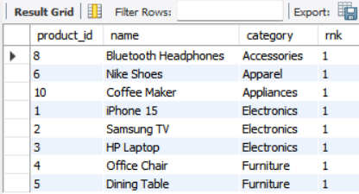
QUERY : Best Sellers by Category
Result
Insight
Shows best sellers within each category to inform merchandising and marketing strategies.
Supports category-level inventory optimization and product development.
10

Slide 11
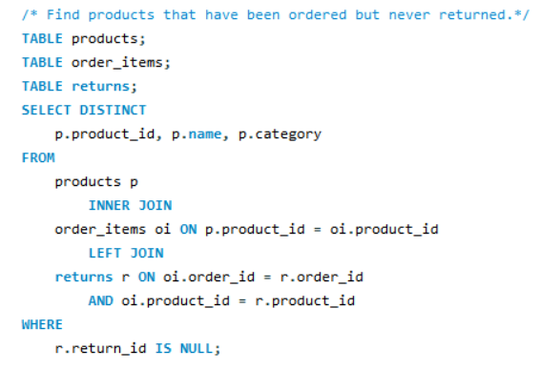
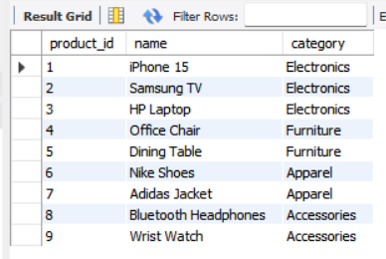
QUERY : Products with Sales and No Returns
Result
Insight
Identifies reliable, high-satisfaction products which could be highlighted in marketing or used as benchmarks.
Indicates products that consistently meet customer expectations.
11

Slide 12
Key Insights from Data
SQL queries reveal top revenue products/customers and return patterns.
Insights suggest focus on return-prone products for quality checks.
Target marketing to highest spending customers.
12

Slide 13
Technical Skills Gained
Complex joins and aggregate functions.
Use of window functions (RANK).
Managing multi-table relationships and foreign keys.
Data analysis through conditional filtering and grouping.
13

Slide 14
Table Creation
CREATE TABLE customers (
cust_id INT AUTO_INCREMENT PRIMARY KEY,
fname VARCHAR(30),
lname VARCHAR(30),
email_id VARCHAR(50),
join_date DATE
);
CREATE TABLE orders(
order_id INT AUTO_INCREMENT PRIMARY KEY,
cust_id INT,
order_date DATE,
CONSTRAINT FOREIGN KEY (cust_id) REFERENCES customers(cust_id)
);
CREATE TABLE order_items(
order_id INT,
product_id INT,
quantity INT,
unit_price DECIMAL(10,2),
PRIMARY KEY (order_id, product_id),
CONSTRAINT FOREIGN KEY (order_id) REFERENCES orders(order_id),
CONSTRAINT FOREIGN KEY (product_id) REFERENCES products(product_id)
);
CREATE TABLE returns(
return_id INT AUTO_INCREMENT PRIMARY KEY,
order_id INT,
product_id INT,
return_date DATE,
reason VARCHAR(100),
CONSTRAINT FOREIGN KEY (order_id, product_id) REFERENCES order_items(order_id, product_id)
);
CREATE TABLE products(
product_id INT AUTO_INCREMENT PRIMARY KEY,
name VARCHAR(50),
category VARCHAR(50),
price DECIMAL(10,2)
);
14

Slide 15
Populating Data
INSERT INTO customers (fname, lname, email_id, join_date) VALUES
('John', 'Doe', 'john.doe@gmail.com', '2025-03-01'),
('Jane', 'Smith', 'jane.smith@yahoo.com', '2025-03-05'),
('Alice', 'Johnson', 'alice.j@gmail.com', '2025-03-15'),
('Bob', 'Williams', 'bob.w@hotmail.com', '2025-03-20'),
('Eve', 'Brown', 'eve.b@rediff.com', '2025-04-01'),
('Charlie', 'Davis', 'charlie.d@protonmail.com', '2025-04-10'),
('Grace', 'Miller', 'grace.m@gmail.com', '2025-04-12'),
('David', 'Wilson', 'david.w@gmail.com', '2025-04-20'),
('Olivia', 'Moore', 'olivia.m@gmail.com', '2025-04-25'),
('Liam', 'Taylor', 'liam.t@outlook.com', '2025-05-01'),
('Sophia', 'Anderson', 'sophia.a@gmail.com', '2025-05-05'),
('Mason', 'Thomas', 'mason.t@gmail.com', '2025-05-08'),
('Isabella', 'Jackson', 'isabella.j@gmail.com', '2025-05-12'),
('Lucas', 'White', 'lucas.w@gmail.com', '2025-05-20'),
('Mia', 'Harris', 'mia.h@gmail.com', '2025-05-25');
INSERT INTO order_items (order_id, product_id, quantity, unit_price) VALUES
(1,1,1,1200.00), (1,8,2,60.00),
(2,4,1,150.00),
(3,2,1,800.00), (3,7,1,90.00),
(4,6,2,120.00),
(5,5,1,400.00), (5,10,1,85.00),
(6,9,1,200.00),
(7,3,1,1000.00), (7,8,1,60.00),
(8,4,1,150.00),
(9,6,1,120.00), (9,9,1,200.00),
(10,2,1,800.00),
(11,1,1,1200.00), (11,8,1,60.00),
(12,5,1,400.00),
(13,3,1,1000.00), (13,10,1,85.00),
(14,7,2,90.00),
(15,9,1,200.00),
(16,1,1,1200.00), (16,6,1,120.00),
(17,2,1,800.00),
(18,5,1,400.00),
(19,8,3,60.00),
(20,10,1,85.00),
(21,4,1,150.00), (21,7,1,90.00),
(22,3,1,1000.00),
(23,9,1,200.00),
(24,6,1,120.00),
(25,8,1,60.00);
INSERT INTO returns (order_id, product_id, return_date, reason) VALUES
(1,8,'2025-06-03','Defective item'),
(5,10,'2025-06-06','Not as described'),
(9,6,'2025-06-11','Wrong size'),
(13,10,'2025-06-15','Did not like'),
(20,10,'2025-06-20','Stopped working');
INSERT INTO products (name, category, price) VALUES
('iPhone 15', 'Electronics', 1200.00),
('Samsung TV', 'Electronics', 800.00),
('HP Laptop', 'Electronics', 1000.00),
('Office Chair', 'Furniture', 150.00),
('Dining Table', 'Furniture', 400.00),
('Nike Shoes', 'Apparel', 120.00),
('Adidas Jacket', 'Apparel', 90.00),
('Bluetooth Headphones', 'Accessories', 60.00),
('Wrist Watch', 'Accessories', 200.00),
('Coffee Maker', 'Appliances', 85.00);
INSERT INTO orders (cust_id, order_date) VALUES
(1, '2025-05-01'), (2, '2025-05-02'), (3, '2025-05-03'),
(4, '2025-05-05'), (5, '2025-05-06'), (6, '2025-05-07'),
(7, '2025-05-08'), (8, '2025-05-09'), (9, '2025-05-10'),
(10, '2025-05-12'), (11, '2025-05-15'), (12, '2025-05-16'),
(13, '2025-05-18'), (14, '2025-05-20'), (15, '2025-05-22'),
(1, '2025-06-01'), (3, '2025-06-03'), (5, '2025-06-04'),
(7, '2025-06-05'), (9, '2025-06-06'), (11, '2025-06-07'),
(13, '2025-06-10'), (15, '2025-06-12'), (2, '2025-06-15'),
(4, '2025-06-18');
15

